Slide 1
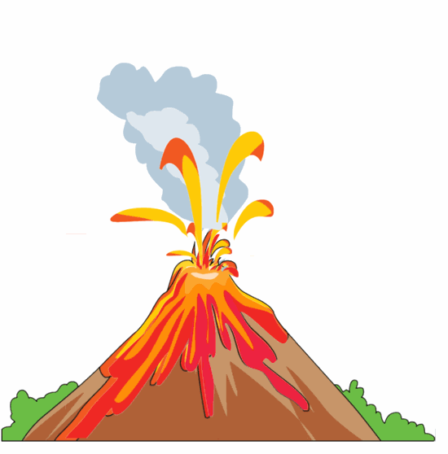
Getting to know volcanoes
Looking at volcanic activity in the Irish context

Slide 2
True or False
Instructions: Read the statements and use your knowledge to decide if the statement is true or false.
1. A dormant volcano has not erupted in many hundreds of years but may erupt again | T | F
2. The Ring of Fire stretches in a north-south direction in the Atlantic Ocean | T | F
3. Volcanic activity has never taken place in Ireland | T | F
4. Mount Etna is an active volcano | T | F
5. The lighter the colour of the lava, the runnier it is. | T | F

Slide 3
True or False
Instructions: Read the statements and use your knowledge to decide if the statement is true or false.
1. A dormant volcano has not erupted in many hundreds of years but may erupt again | True | F
2. The Ring of Fire stretches in a north-south direction in the Atlantic Ocean | T | False
3. Volcanic activity has never taken place in Ireland | T | False
4. Mount Etna is an active volcano | True | F
5. The lighter the colour of the lava, the runnier it is. | True | F

Slide 4
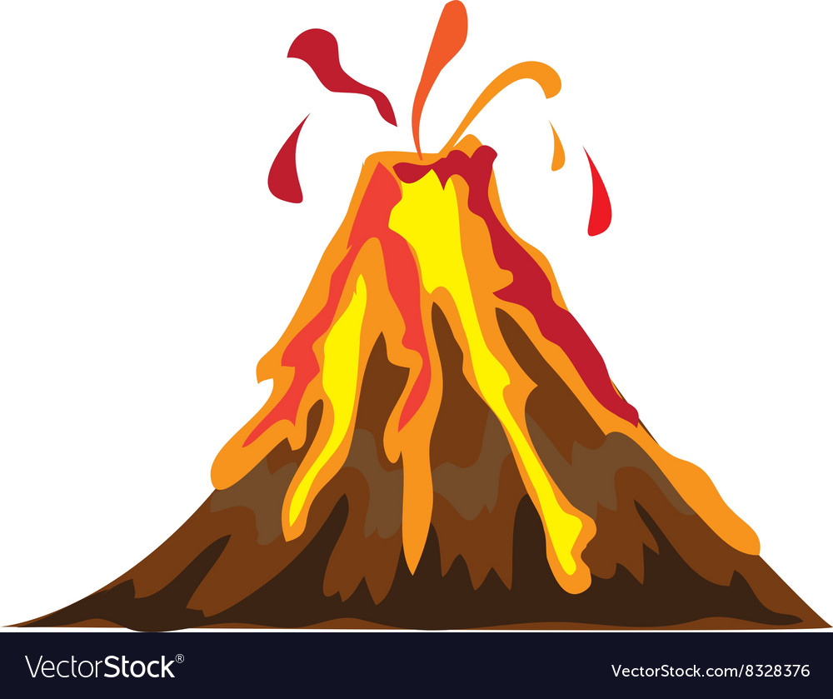
Why should we care about volcanoes?
What is their effect on society and our planet?

Slide 5
Footage of La Palma eruption

Slide 6
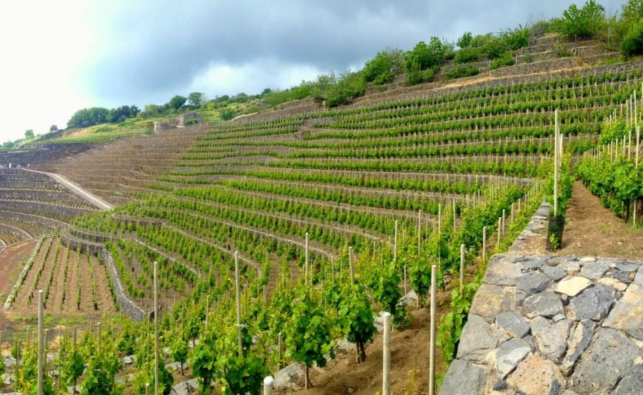
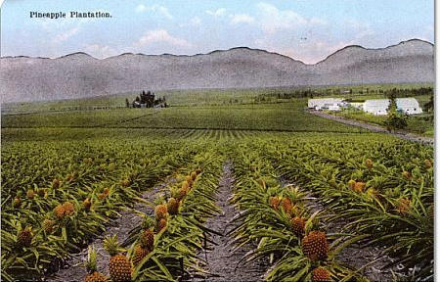
Positive impact on Society – Fertile soil
Vines growing on Mt Etna
Pineapples growing in Hawaii
Notes:
Volcanic materials can produce fertile soils and so are very suitable for agriculture.

Slide 7
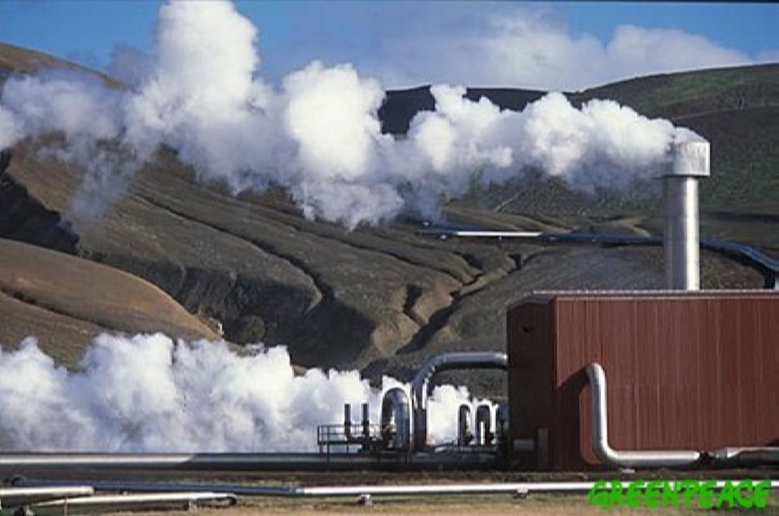
Positive impact on Society – Geothermal energy
Geothermal energy uses in Iceland
1. To produce electricity & provide hot water for heating
2. To keep pavements and car parks ice-free
3. To heat greenhouses
4. To dry fish and seaweed
5. In fish farms
6. To heat swimming pools/hot pools/spas
Geothermal energy plant near Reykjavik

Slide 8
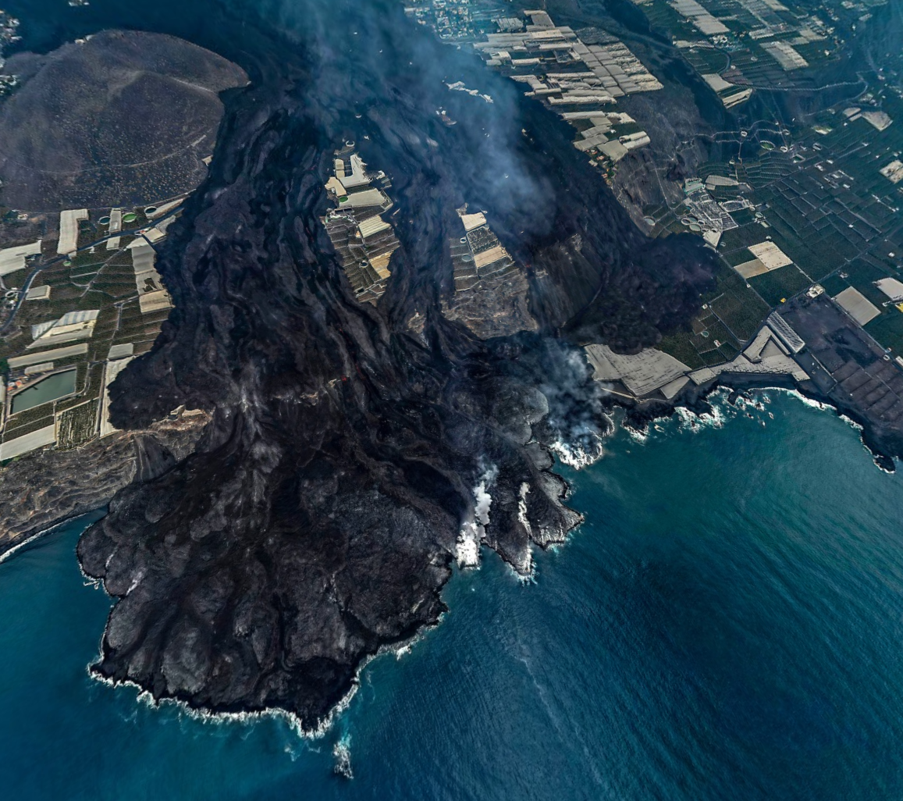
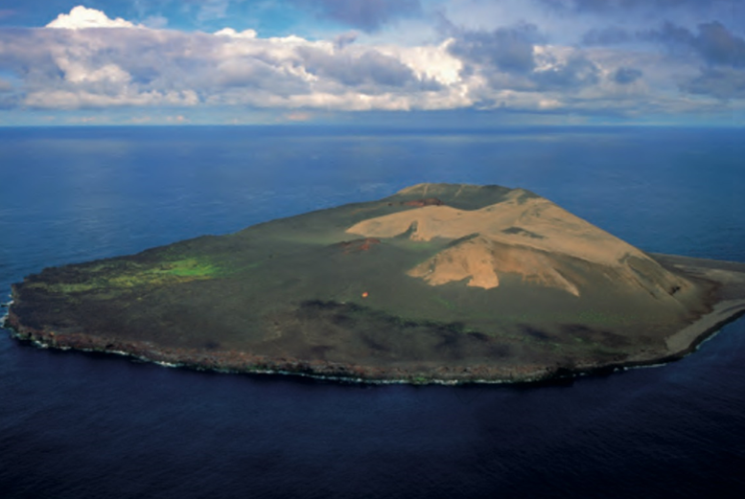
Positive impact on Society – New land
La Palma
Surtsey Island
Notes:
Volcanic activity can create new land e.g. La Palma, Surtsey Island (1963-1967, 32 kms off the southern coast of Iceland)

Slide 9
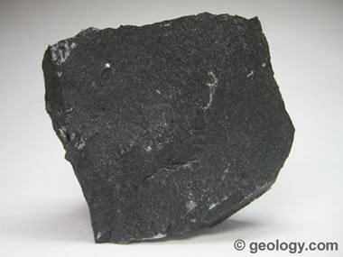
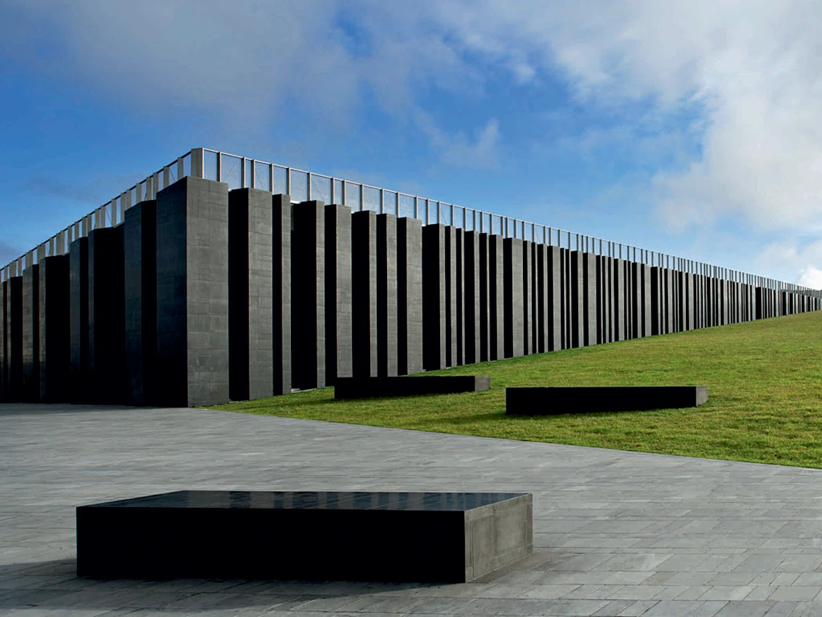
Positive impact on Society – Building materials
Giant Causeway Visitor Centre consists of 209 basalt columns
Notes:
Basalt is used in tarmac to surface roads

Slide 10
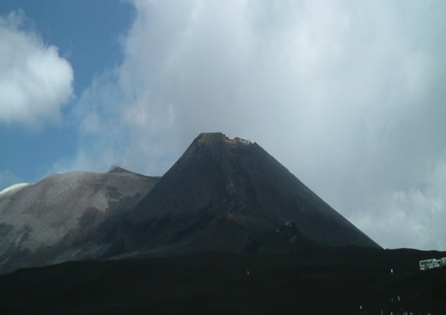
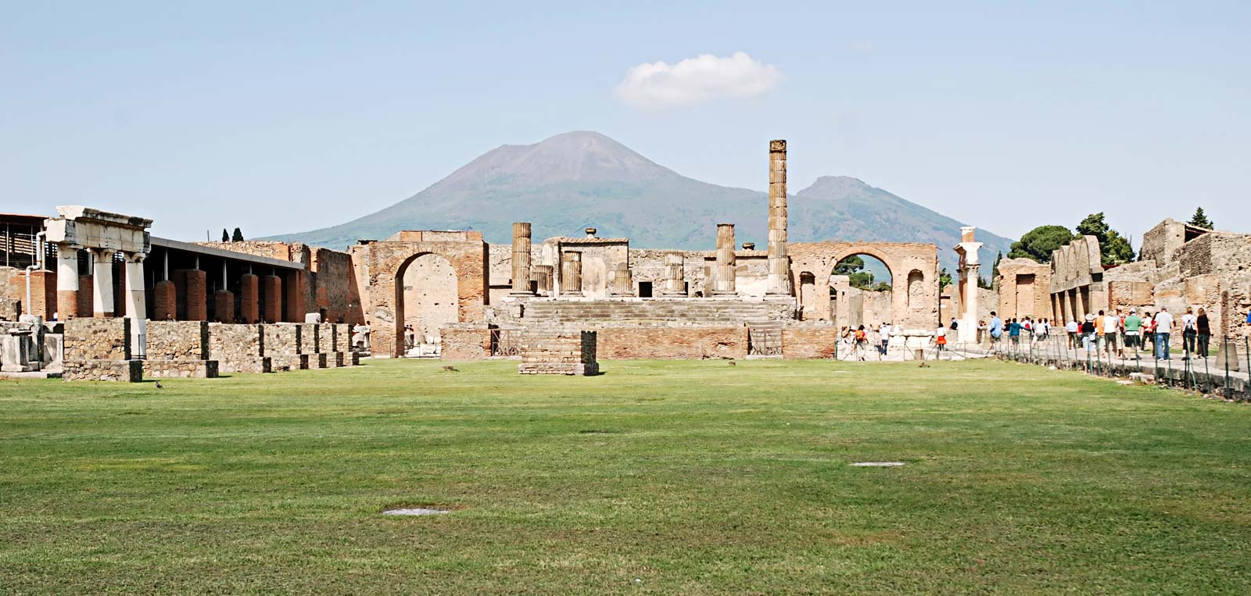
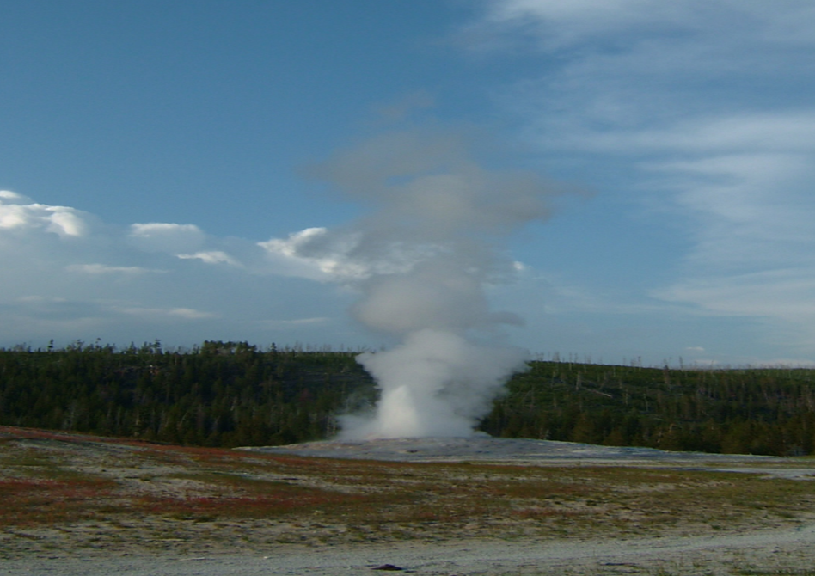
Positive impact on Society – Tourism
Mt Etna
Pompeii
Old Faithful in Yellowstone

Slide 11
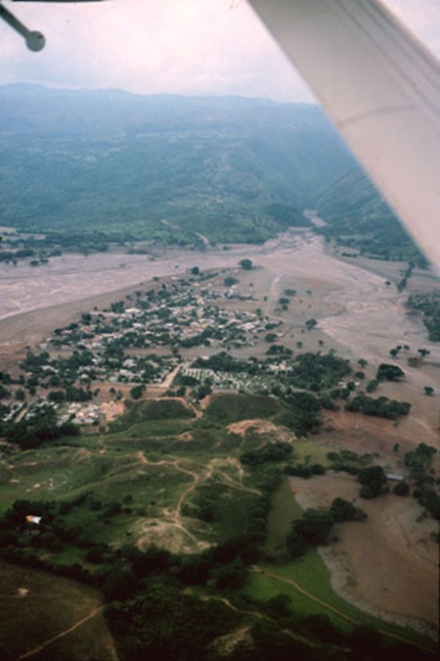
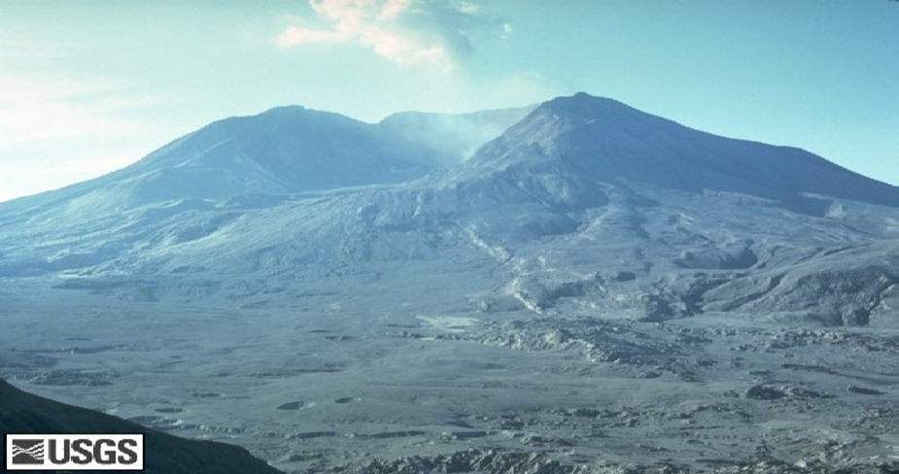
Negative impacts - Deaths
Pompeii
20,000 deaths in 7AD
Mt St Helens
57 deaths in 1980
Nevado del Ruiz lahar in Colombia
22,000 deaths in 1985

Slide 12
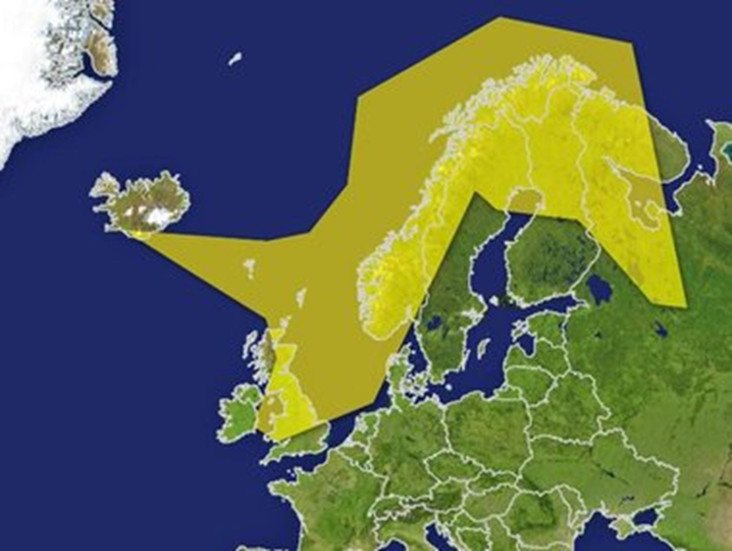
Negative impact – Ash clouds disrupt air travel
Ash cloud covering Europe in 2010
Notes:
When the volcano in Eyjafjallajokull, Iceland erupted in 2010, air travel was shut down over much of Europe for 10 days.

Slide 13
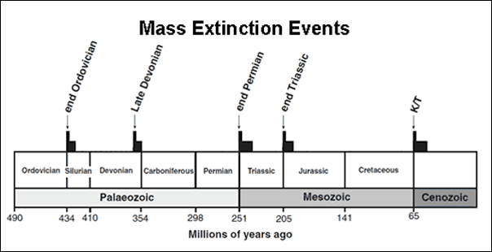
Impact on the Planet - volcanoes caused mass extinctions
The Big 5
In each event > 50 % of Earth’s species became extinct

Slide 14
Impact on the Planet - volcanoes caused mass extinctions
Dinogorgan
The Dinogorgon vanished in the greatest mass extinction ever around 252 Mya (the Permian-Triassic) along with about nine of every ten plant and animal species on the planet.
Likely caused by the eruption of the Siberian Traps, an immense volcanic complex that erupted more than 720,000 cubic miles of lava across what is now Siberia.
Notes:
The largest of the five great mass extinctions 252 million years ago (the Permian-Triassic) was likely caused by the eruption of the Siberian Traps. Approximately 90% of the species disappeared at the end of the Permian.
720 000 cubic miles is roughly 700 times as big as the Grand Canyon

Slide 15
Impact on the Planet – volcanoes can cause global climate change
Mount Tambora 1816
Ejected ash and aerosols into the atmosphere.
Sky darkened and the sun was blocked from view over the following months.
Had an effect on climate worldwide as Earth’s average global temperature dropped 3°C.
1816 known as “The Year Without a Summer” in Europe and North America.
Snow fell in New England. Cold rain fell in Europe. Cold, stormy and dark - not like typical summer weather.
Map of unusual cold temperatures in Europe during the summer of 1816

Slide 16
Impact on the Planet – volcanoes can cause global climate change
Volcanic eruptions can produce vast amounts of sulphuric acid aerosols and CO₂ that can cause global climate changes.
The Siberian Traps, an immense volcanic complex that erupted during the Permian-Triassic Period, released more than 720,000 cubic miles of lava which triggered the release of at least 14.5 trillion tons of carbon.
Magma from the Siberian Traps infiltrated coal basins on its way toward the surface, probably releasing even more greenhouse gases such as methane.
In the million years after the event, seawater and soil temperatures rose between 25 to 34 degrees Fahrenheit (-3.8°C to 1.1°C)
At the time, almost no fish lived near the equator.
Notes:
Huge volcanic eruptions can produce vast amounts of sulphuric acid aerosols and CO2 that can cause global climate changes. The eruptions were frequent and long-lasting and their fury spanned a period of hundreds of thousands of years.
This still fairly rapid climate change is believed to be responsible for the species loss

Slide 17
Volcanoes
Not just one type

Slide 18
Volcanoes
Four types
Cinder cone
Composite volcano
Lava dome
Shield volcano

Slide 19
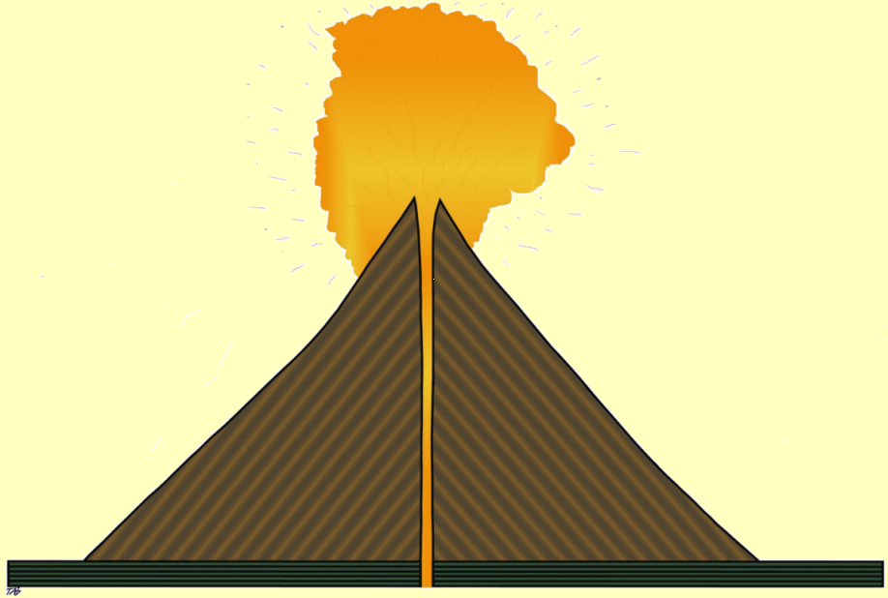
1. Cinder Cone
Examples:
Paracutin – Mexico
The volcano is built up of layers of ASH. When it erupts it is normally with great explosive force.
Volcanic Bombs
Steep sides
Layers of Ash
and Cinder
3,000m
Pipe

Slide 20
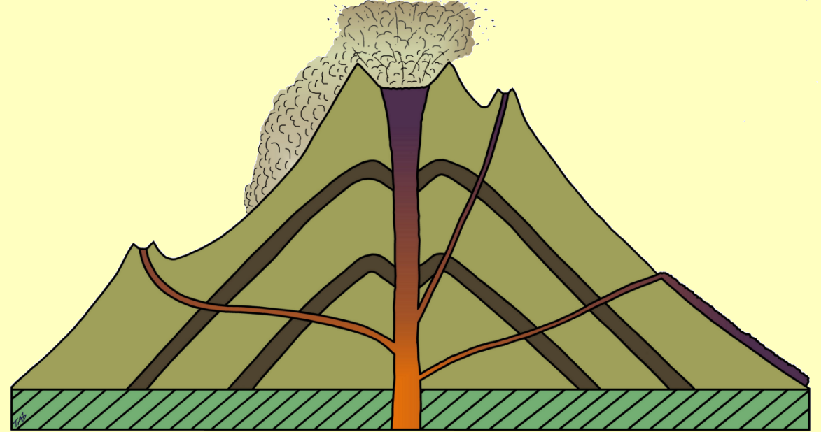
2. Composite (Strato-) Volcano
Examples:
Mt St Helens – USA
Mount Vesuvius
The volcano is built up of alternate layers of LAVA and ASH. They can explode with great violence.
Crater
Pyroclastic Flow
Ash layer
Dyke
Lava Layer
Parasitic cone
Lava
Flow
Crust

Slide 21
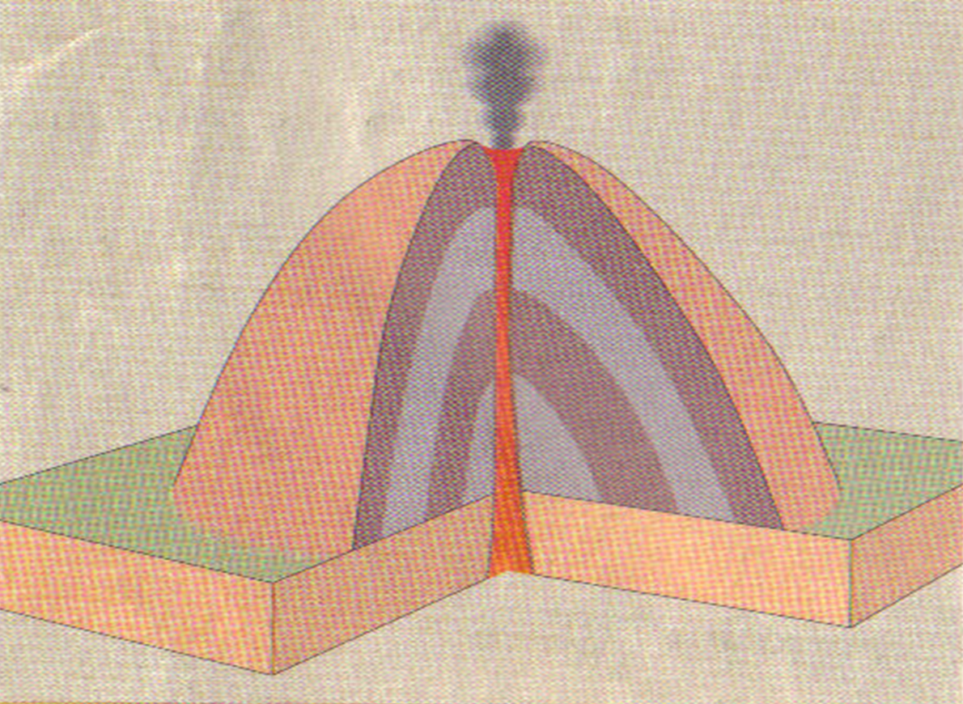
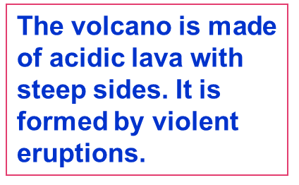
3. Lava Dome

Slide 22
4. Shield Volcano
Examples:
Mauna Loa Hawaii –USA
Volcano made of layers of basic lava with
gentle slopes and a wide/broad base.
They tend not to erupt violently.
Layers of Lava
Lava Flow
10,000m
250 miles

Slide 23
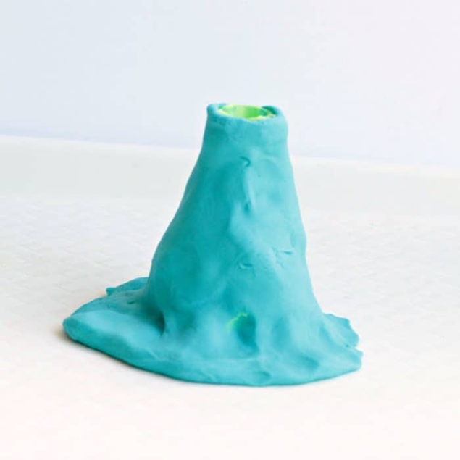
Get into groups of 4
2 different colours of play dough per student – one representing lava, the other cinders
Using a worksheet, each student selects a volcano and makes their own volcano
Students discuss the differences and similarities between the types of volcanoes
The class tries to guess what volcanic cone the student has made
Activity 1
“Guess what type of volcano”

Slide 24
Volcanic products
Lava
Basalt
Pumice
Material ejected into the air (Tephra)
Ash
Lapilli/Cinders
Bombs

Slide 25
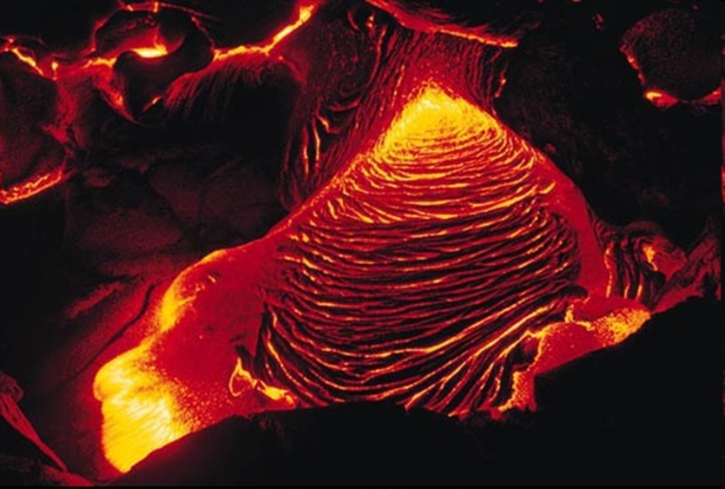
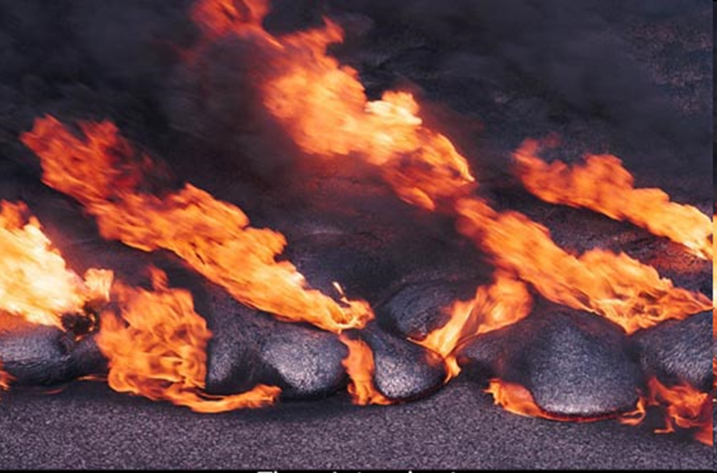
Lava
There are 2 types of lava, classified on its ability to flow.
1. Basic lava - low in silica and very runny.
2. Acidic lava - high in silica and is pasty.
Basic lava
Acidic lava

Slide 26
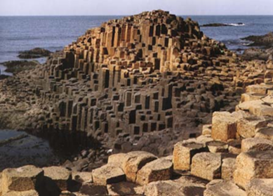
Basalt – Volcanic Rock

Slide 27
Pumice – Volcanic Rock
Pumice
is lava mixed with air causing it to fill up with air bubbles.
is extremely light and brittle.
Was full of hot gas bubbles.
Rock is full of holes
Can float in water
Used as an exfoliator to help tub off dead skin.

Slide 28
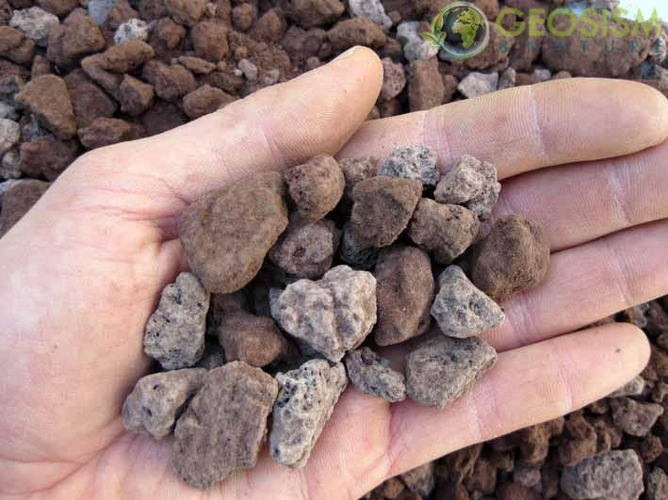
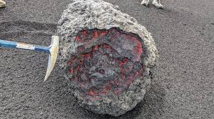
Tephra – Volcanic Ejecta
Classification is purely based on grain size of the ejected material
Volcanic ash < 2 mm
Lapilli 2 mm to 64 mm
Bombs > 64 mm
Volcanic ash from Mt St. Helens
Cinders/Lapilli
Volcanic bomb from La Palma

Slide 29
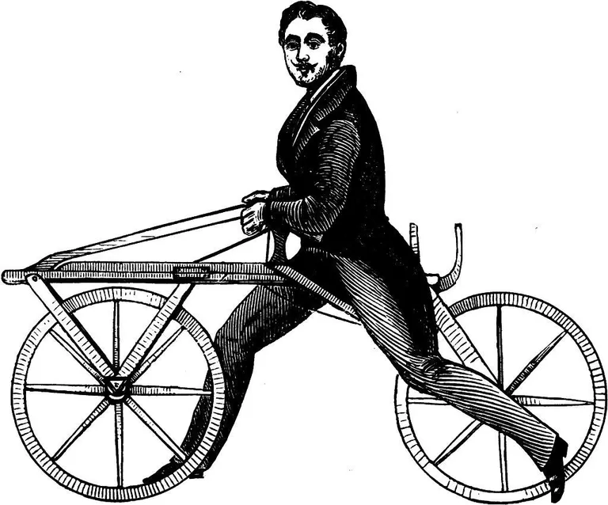
Tephra - Ash
Fact:
A volcano gave us the bike!
Mount Tambora in Indonesia was the direct reason we got the bike 200 years ago.
River and homes covered in volcanic ash

Slide 30
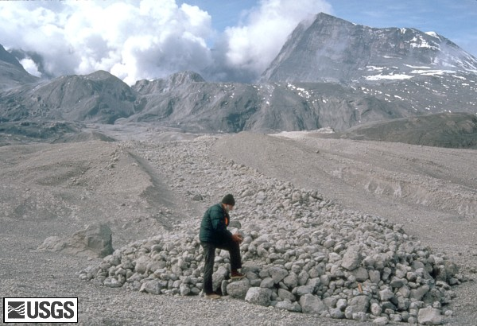
U.S. Geological Survey scientist examines volcanic bombs from Mount St. Helens eruption.
Tephra - Bombs
Fact:
When Mount Kelud in East Java erupted on 14/2/14 it sent bombs
flying 10 miles into the air!

Slide 31
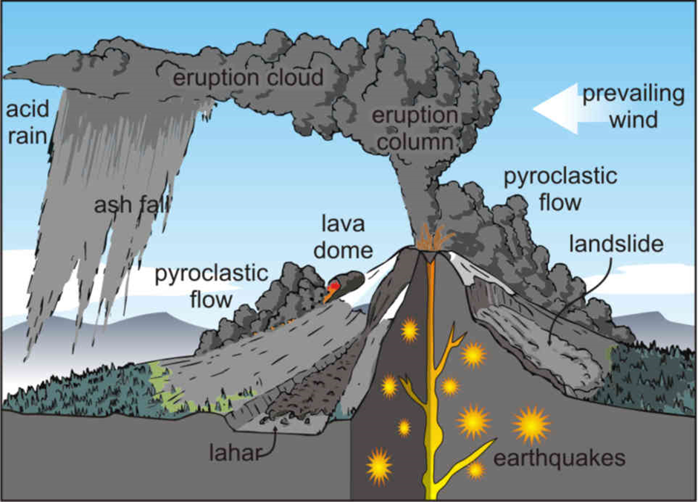
Volcanic hazards

Slide 32
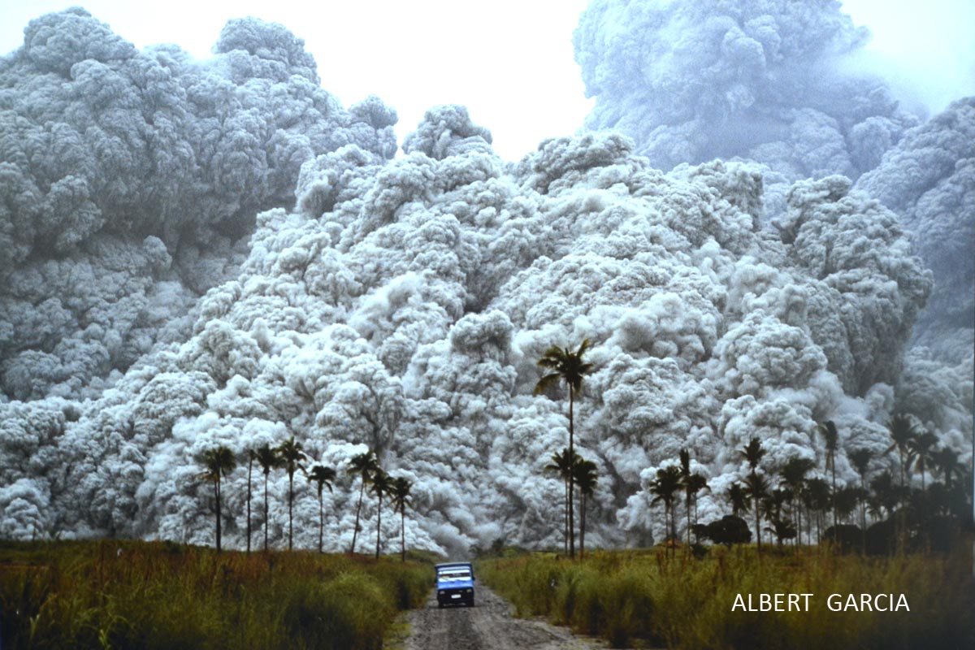
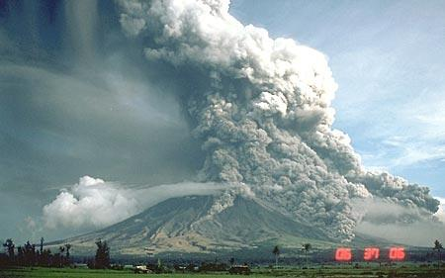
Pyroclastic Flow
A mixture of hot lava, ash and volcanic gases that travel down a volcano at great speeds (200 to 700 km/h).
Mount Pinatubo, Phillipines, 1991
Mayon Volcano, Phillipines, 1984

Slide 33
Lahar
volcanic mudflow
caused by prolonged rain-fall or melting of snow and ice
can flow down slopes at speeds of up to 200 km/hr
Nevado del Ruiz lahar in Colombia in 1985
Notes:
Lahar - most lethal. This is due to their sudden appearance and fast speed.

Slide 34
Cross section of a volcano

Slide 35
Magma Chamber
The ring dykes of Slieve Gullion and Cooley were formed by the collapse of the magma chamber underneath.

Slide 36
Get into pairs
Look at the rock samples
Students have to place the rocks into the blank spaces
Fill in information into fact sheets
Students discuss the differences and similarities between the rocks
Activity 2
Rock identification
Be a Rock
Detective

Slide 37
Volcanic activity in the Irish context

Slide 38
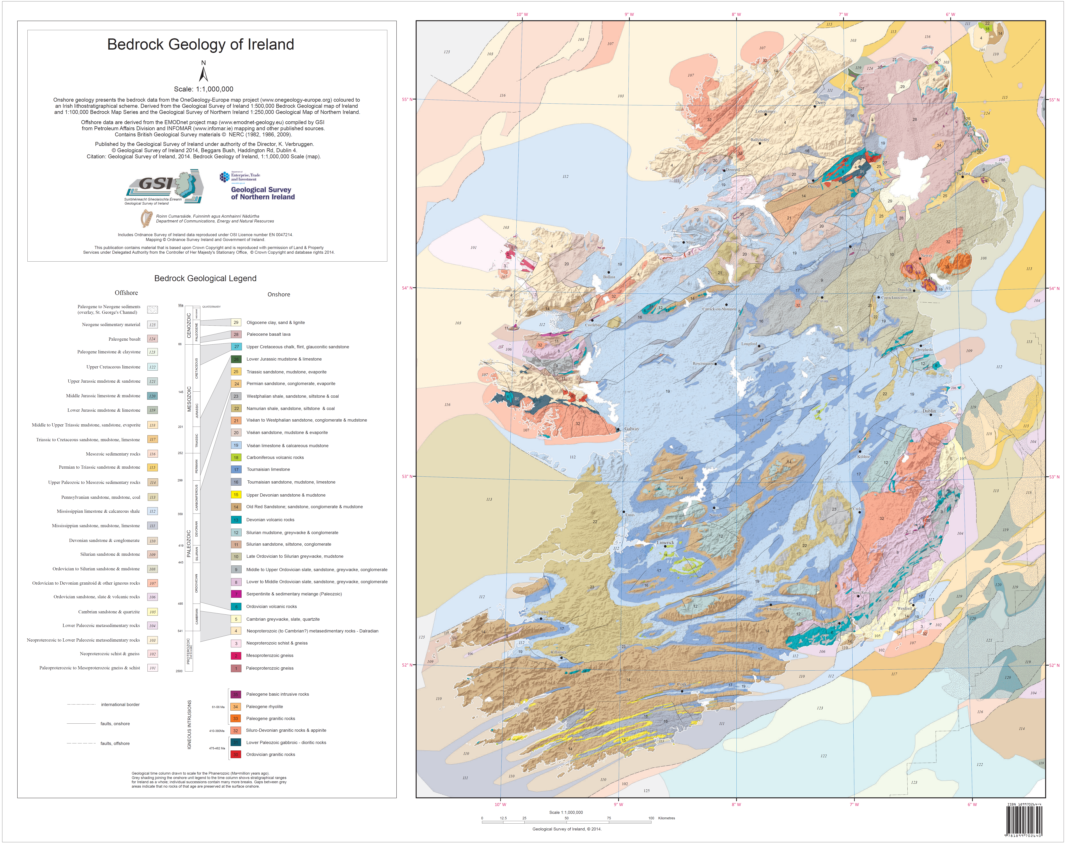
Using the legend,
where do you find major volcanic rocks in Ireland?
Notes:
You could either distribute this map, which can be provided by GSI if you do it in person.
Otherwise you can use the MapViewer
Geological Survey Ireland Spatial Resources (arcgis.com)

Slide 39
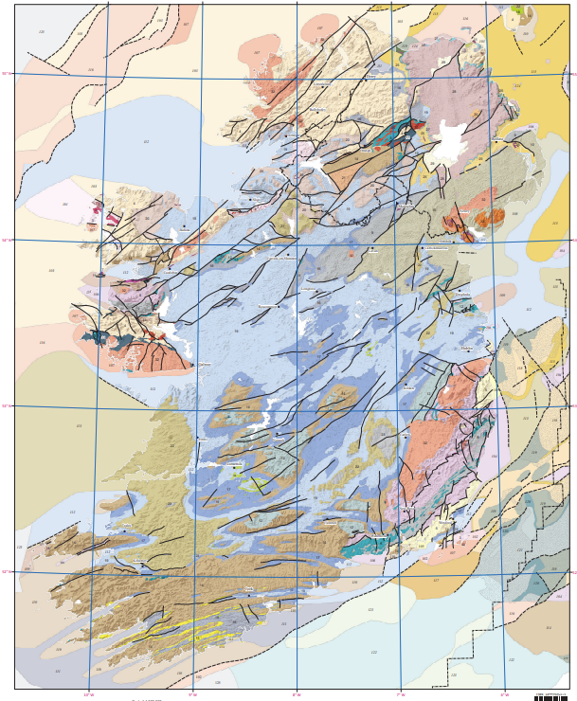
Where do we find Irish volcanic rocks?
Ordovician volcanic rocks
Carboniferous volcanic rocks
Paleocene volcanic rocks

Slide 40
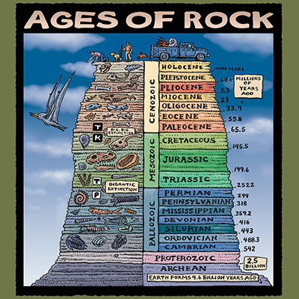

Slide 41
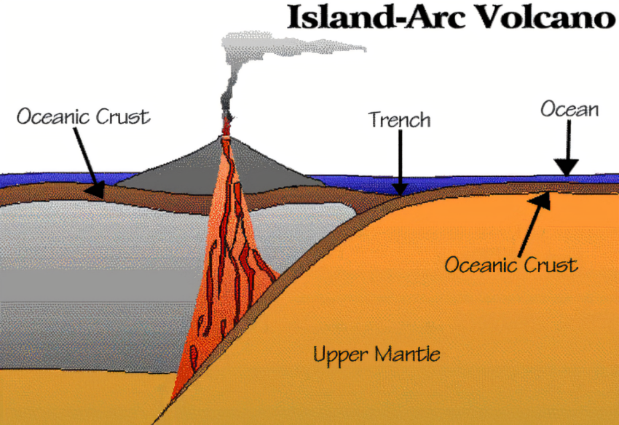
Ordovician Volcanism
c. 430 to 480 Ma
North of Ireland (& Scotland) was part of Laurentia (North America & Greenland), South of Ireland (England & Wales) was part of Avalonia
Resulted in Island-arc volcanism
created by converging plate boundaries (similar to Japan today)
submarine volcanoes that tend to be explosive
Examples: coastline of Waterford, Arklow Head (County Wicklow), Lambay Island

Slide 42
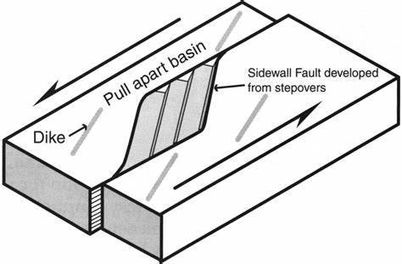
Carboniferous Volcanism
c. 350 Ma
Ireland is now one landmass
Volcanism close to Limerick maybe caused due to the formation of a pull-apart basin → crustal extension / thinning
7 volcanic centres in Limerick area
Other Irish example: Croghan Hill (Co. Offaly)
volcanic centre

Slide 43
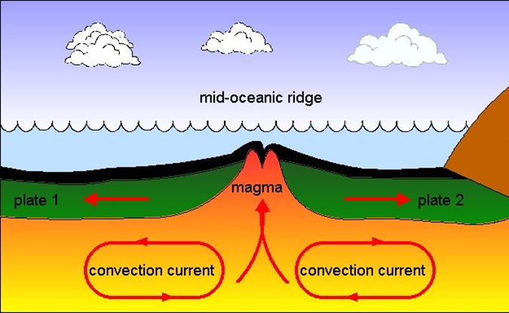
Paleocene Volcanism
c. 60 Ma
Final burst of volcanic activity in Ireland that lasted for about 15 million years.
volcanoes began to erupt because of an upwelling of hot magma from
inside the earth. This is known as mantle plume.
Ireland was attached to America but a string of volcanoes burst through the crust in a line that ran through Northern Ireland.
Led to the birth of the Atlantic Ocean.
Reopening of the Atlantic caused sea floor spreading
Sea floor spreading caused increased volcanic activity
schematic picture north atlantic igneous province - Bing images

Slide 44
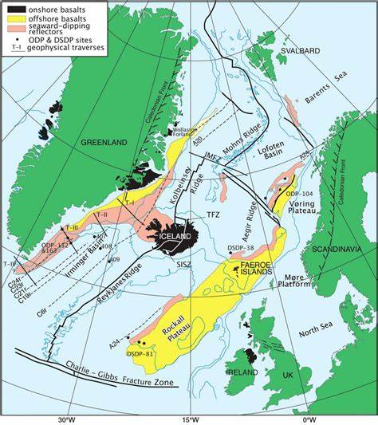
Paleocene Volcanism
North Atlantic Igneous Province was built (Basaltic lava plateau)
1.3 Mio. km² in area
6.6 Mio km³ in volume
Plateau broke up leaving remnants in Northern Ireland (Giant’s Causeway), west Scotland, the Faroe Islands, northwest Iceland, east Greenland, western Norway
schematic picture north atlantic igneous province - Bing images

Slide 45
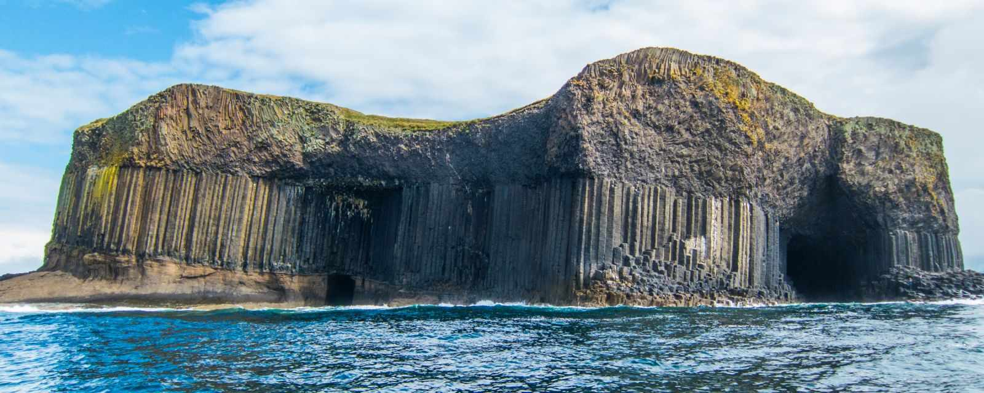
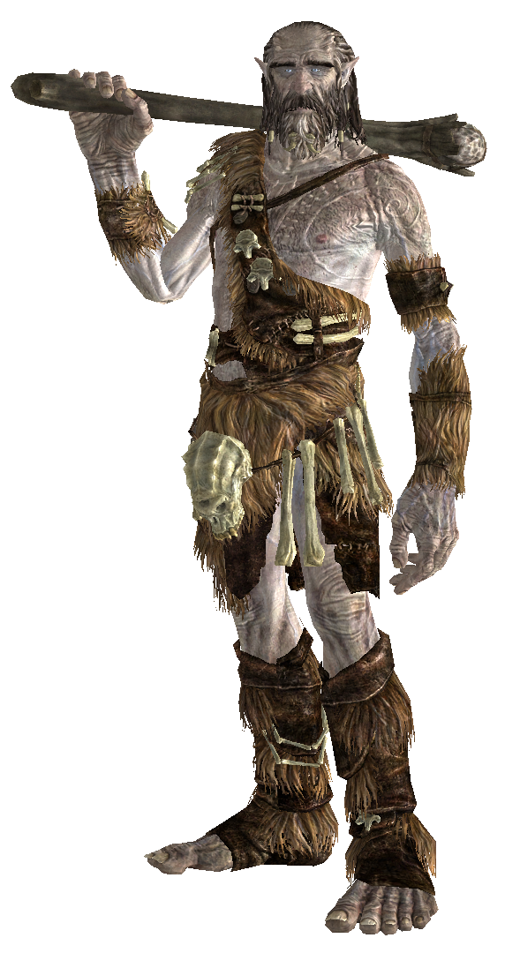
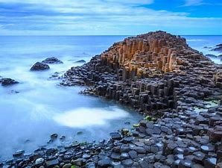
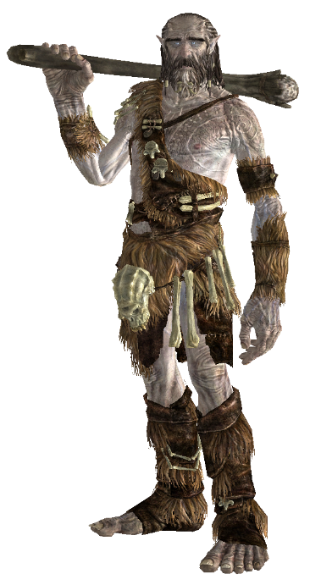
Isle of Staffa – Fingal’s Cave
Giant’s Causeway

Slide 46
Volcanism around Cavan
Which one is the closest eruption?
Eruption Age
What type of volcanic rocks erupted

Slide 47
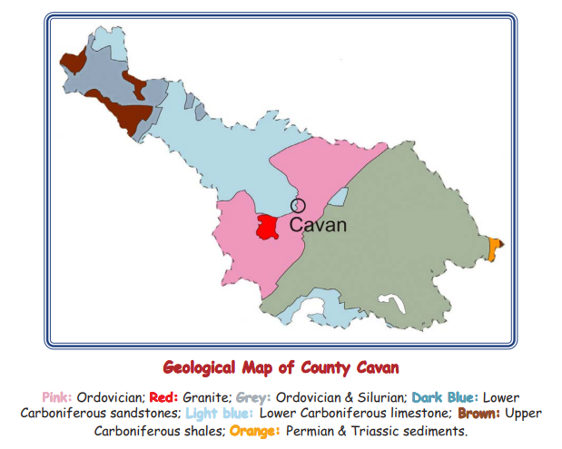
County Cavan
Geological history The oldest rocks in County Cavan are 417-495 million years old [Ma] and consist of mudstones and volcanic rocks. At that time Ireland lay beneath a deep ocean, on the edge of an ancient continent made up of Scotland, north America and the north of Ireland. A huge ocean separated this continent from the rest of Ireland, England, Wales and Europe. Over millions of years, this ocean closed and the two ancient continents collided, heating and deforming the rocks to form slates. The same rock types occur from Longford, through Cavan, County Down and into the Southern Uplands of Scotland. Plate tectonic movements closed the ocean and the ocean floor rocks were faulted in slivers against the northern side. County Cavan now has these slivers of slate and sandstones stacked up across the southern half of the county. Only where a few graptolite fossils occur in the black slates can we work out the actual age and structure of the rocks.
Notes:
Geological history The oldest rocks in County Cavan are 417-495 million years old [Ma] and consist of mudstones and volcanic rocks. At that time Ireland lay beneath a deep ocean, on the edge of an ancient continent made up of Scotland, north America and the north of Ireland. A huge ocean separated this continent from the rest of Ireland, England, Wales and Europe. Over millions of years, this ocean closed and the two ancient continents collided, heating and deforming the rocks to form slates. The same rock types occur from Longford, through Cavan, County Down and into the Southern Uplands of Scotland. Plate tectonic movements closed the ocean and the ocean floor rocks were faulted in slivers against the northern side. County Cavan now has these slivers of slate and sandstones stacked up across the southern half of the county. Only where a few graptolite fossils occur in the black slates can we work out the actual age and structure of the rocks.

Slide 48
Three-Two-One!
3 things I learned from today’s class
1.
2.
3.
2 things I found most useful from today’s class
1.
2.
1 question I have that I want to learn more about from today’s class
1.

Slide 49
References
www.gsi.ie
https://www.bbc.co.uk/bitesize/guides/z8p9j6f/revision/1
https://www.nationalgeographic.com/science/article/mass-extinction
https://scied.ucar.edu/learning-zone/how-climate-works/mount-tambora-and-year-without-summer
https://www.ringofgullion.org/geology/

Slide 50
Acknowledgements
Sincere thanks to iCRAG and Geological Survey Ireland for hosting this course for LC Geography teachers especially Elspeth Sinclair and Amrine Dubois Gafar. Thanks to all the researchers who presented lectures in Week 1, 2 and 3. A special thanks to Hilde Koch, Maurice Brodbeck and Siobhán Power for helping me to develop the content of these slides.
Finally thanks to all the participating teachers who kindly shared ideas and resources.

